Slide 1
Inclusive Documents Authoring of accessible content
December 5, 2017
Peter Frem
Senior Program Manager
Microsoft Office

Slide 2
“No one should have to ask for access, it should just be there.”
Marlee Matlin
Academy Award Winning Actress
Outside In Talk at Microsoft
December 2016
Notes:
Marlee Matlin won the Academy Award for Best Actress for Children of a Lesser God in 1986 and is the only deaf performer to win the award.
Learn more at https://blogs.microsoft.com/jobs/qa-actress-author-producer-marlee-matlin/

Slide 3
Microsoft Office Accessiblity Mission
People with disabilities can create, consume, and communicate from any device
It’s easy for everyone to create accessible content

Slide 4
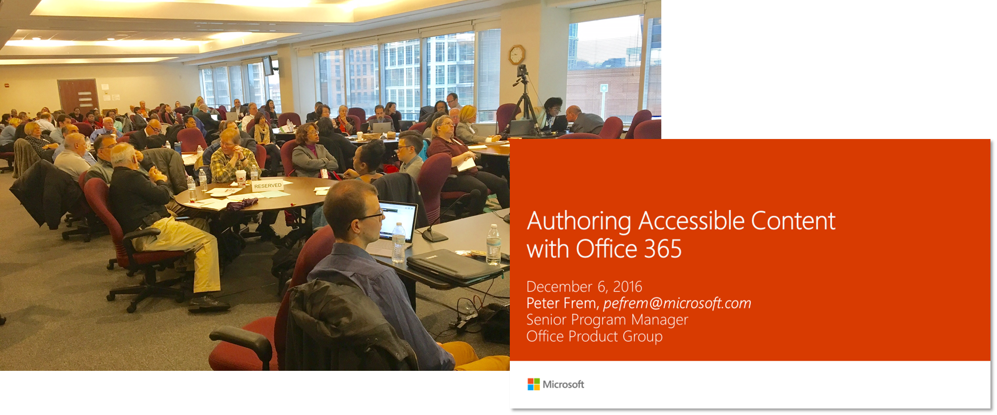
Looking back

Slide 5
Office’s Accessible-Authoring Journey December 2016
Office 2010 | Generally Available in Office 365 | Coming Soon to Office 365
Remediation-centric Accessibility checker in Word, Excel, PowerPoint Desktop Available at no cost, offline, no further installations required | New Prevention Capabilities Improved accessible templates and default themes New accessible authoring capabilities in any app on any device (e.g. alt text, headers) New intelligent services for faster creation of more accessible content (Designer, Editor) Improved Remediation Improved accessibility checker workflow, in-app guidance, and help documentation New accessibility checker in Desktop, Mac, and Web apps Improved tagged PDF generation New Sharing Capabilities New acc checker in Outlook New reminders when sending emails to users who prefer accessible content in OWA | Automatic alt text suggestions Automatic accessible hyperlinks to recent Office documents Updated acc checker categories and rules Reminders when sending emails in Outlook

Slide 6
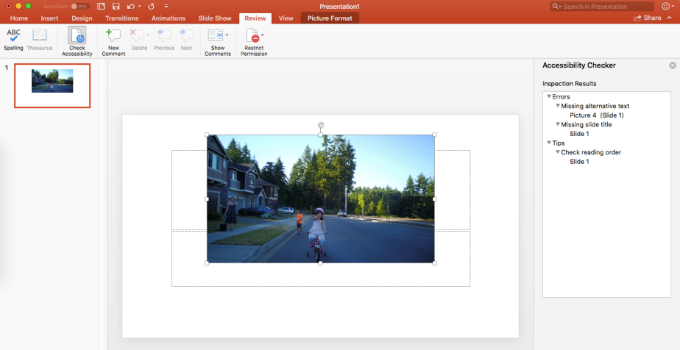
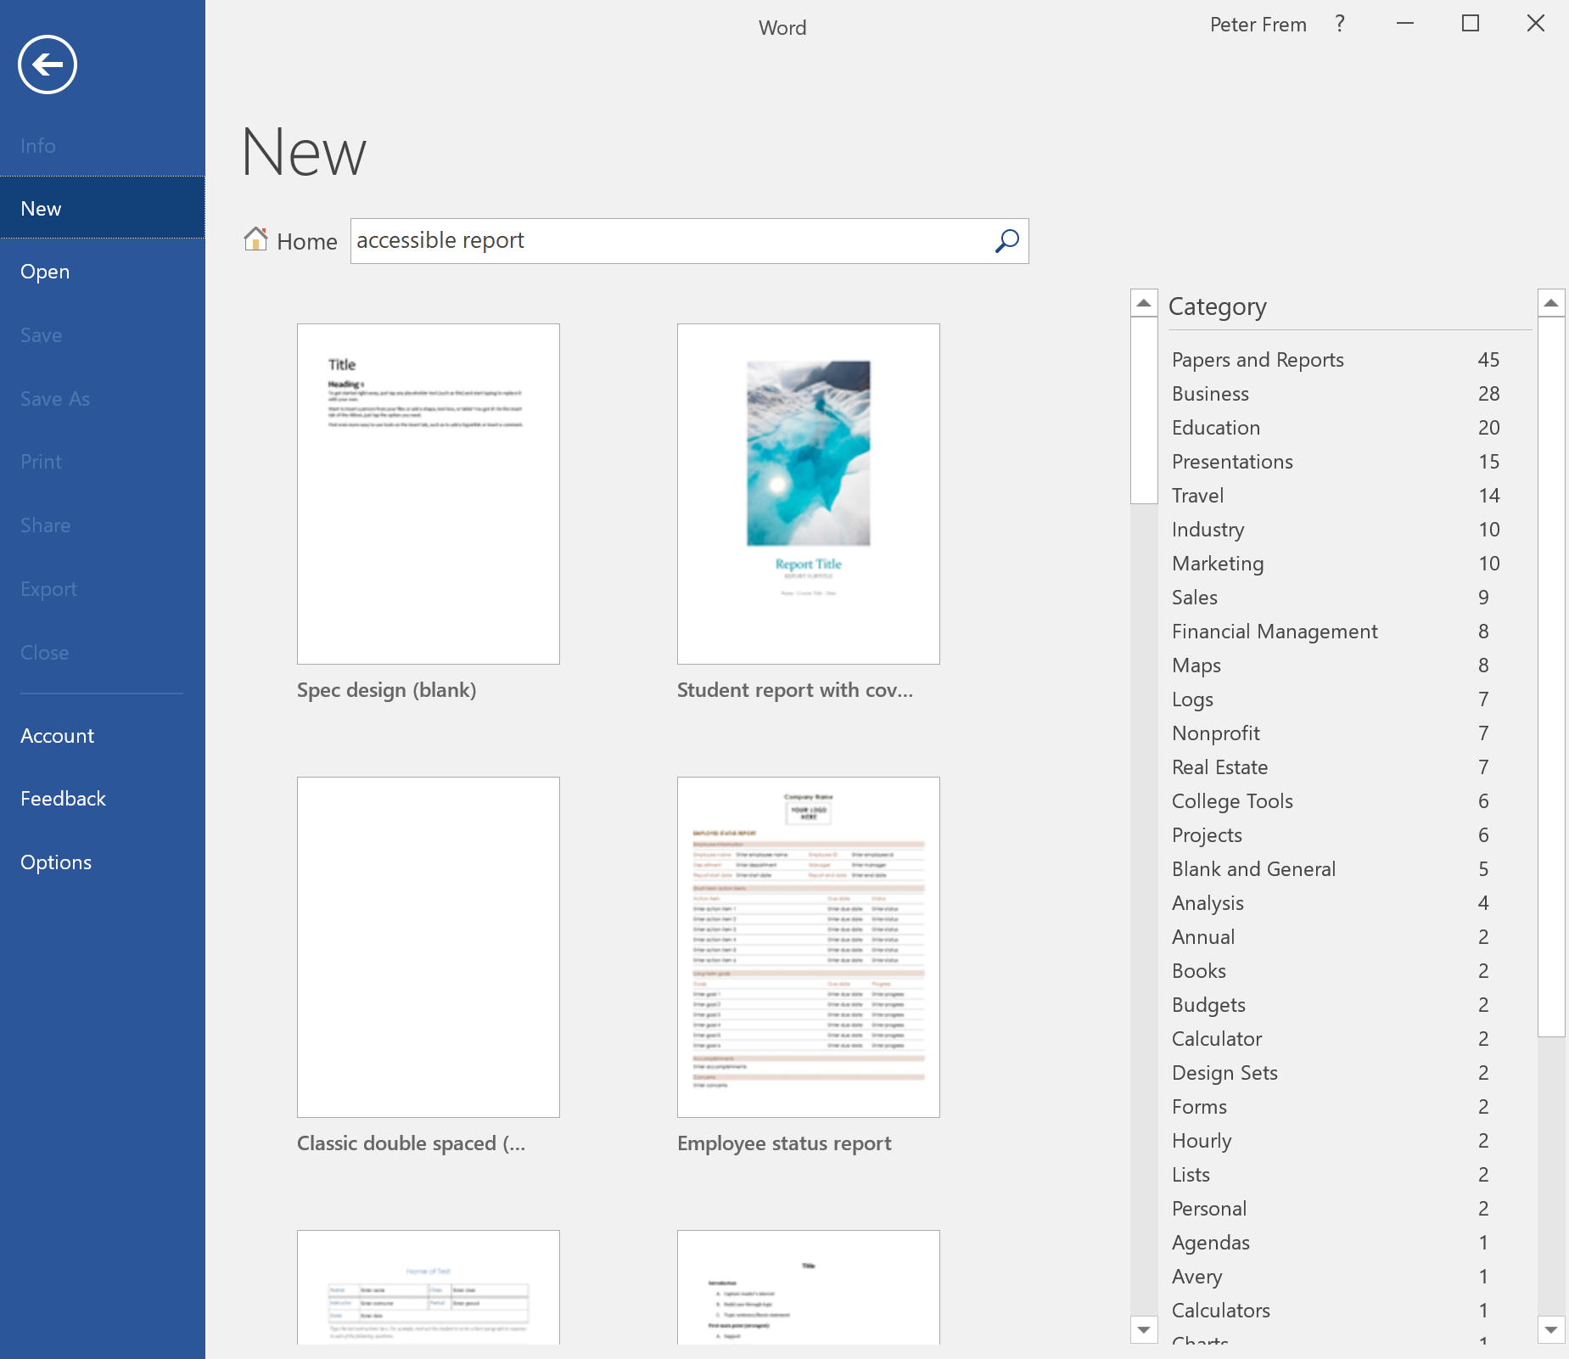
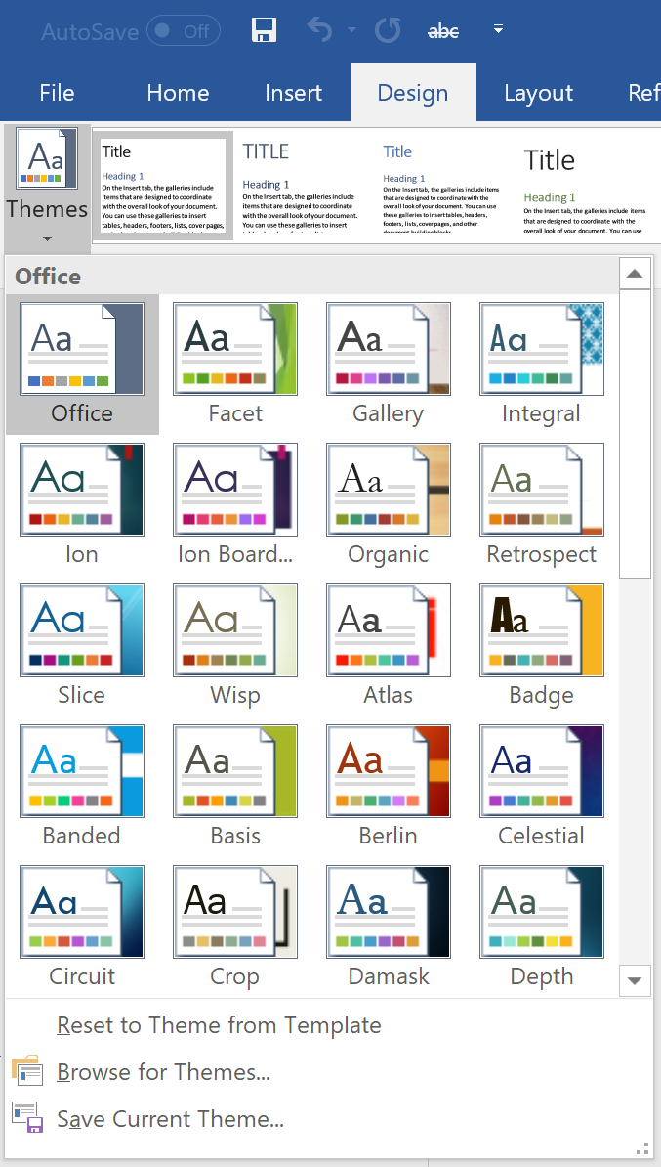
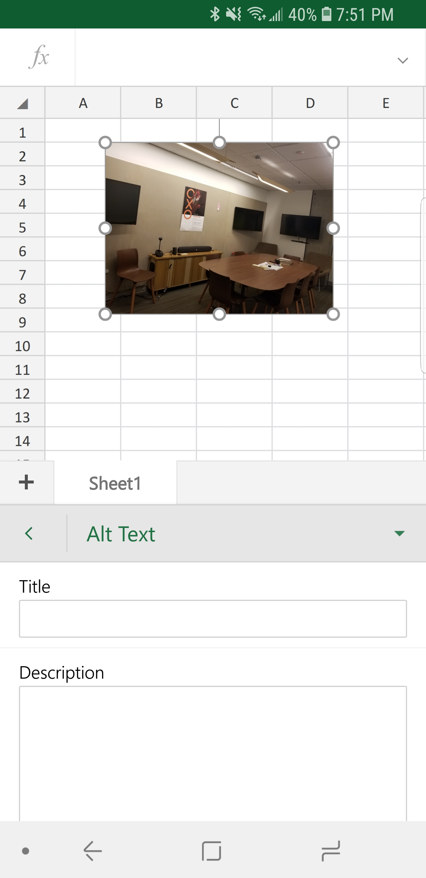
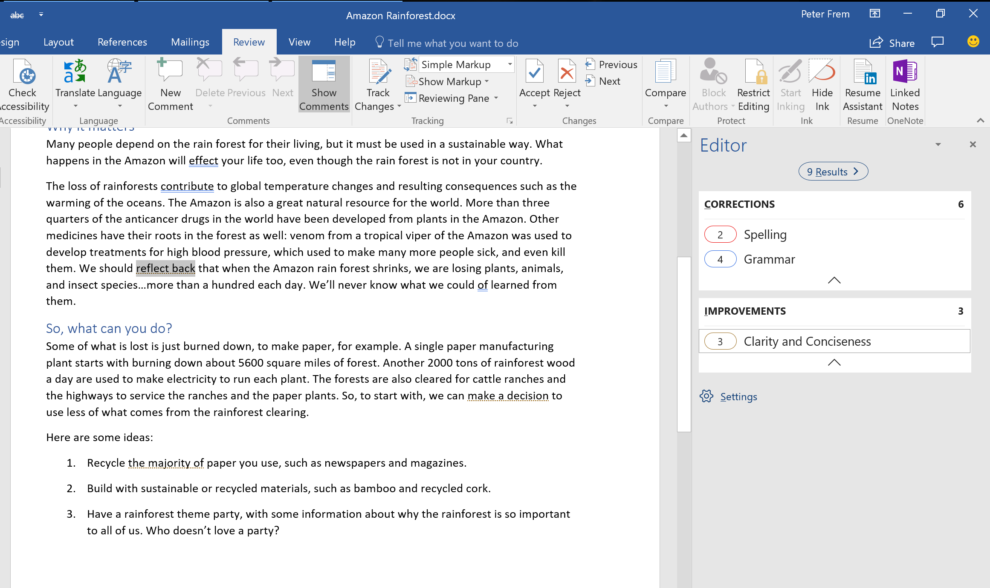
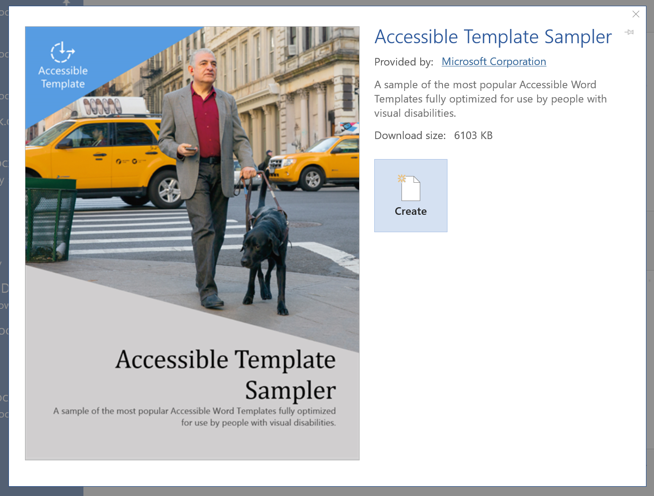
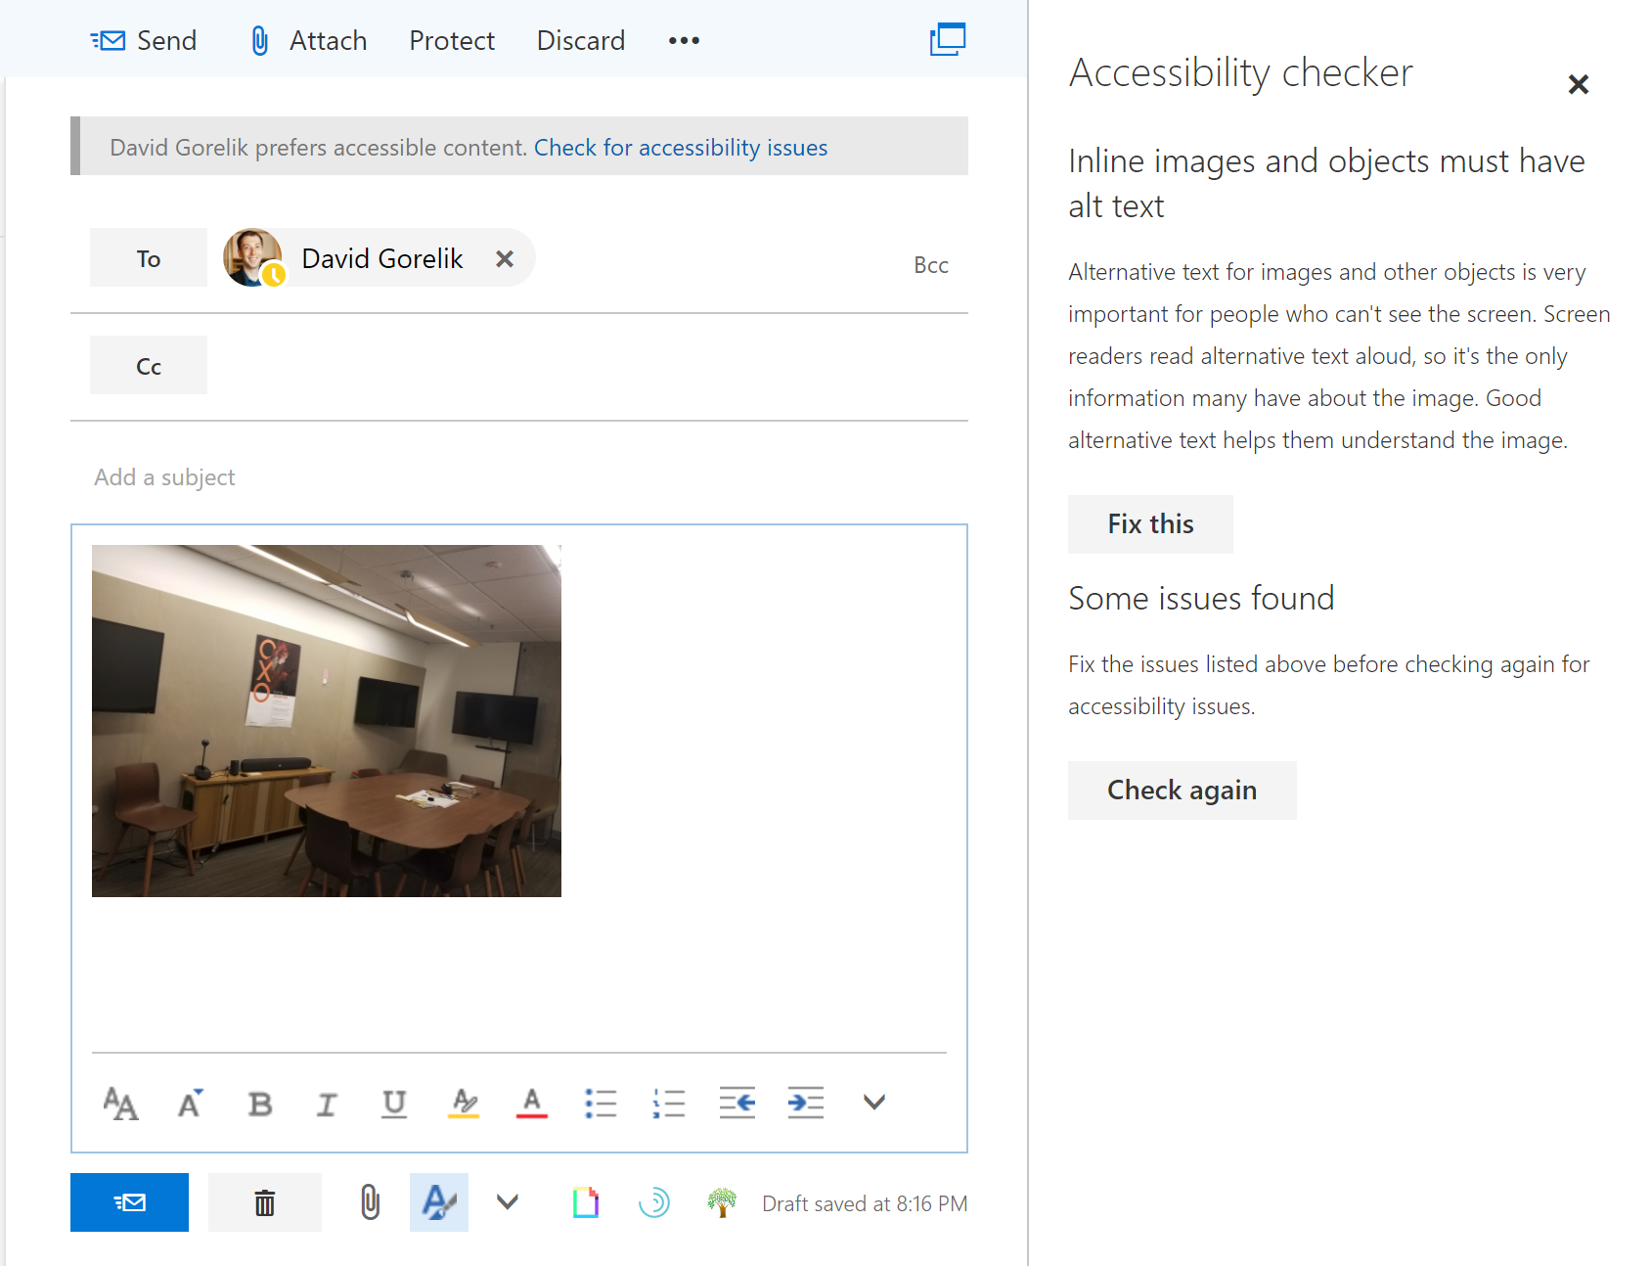
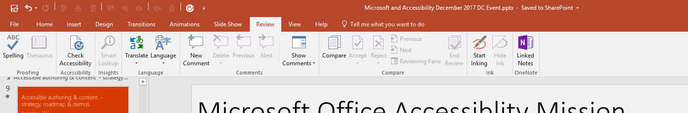
Last year’s Demos

Slide 7
Impact of some of these changes
<show chart of acc checker usage before/after moving the UI to ribbon>
Users
~4x increase in average monthly users comparing Sep-Nov 2016 vs. 2017
Word currently averaging ~250K users monthly
Usage
<clicks>

Slide 8
Office’s Accessible-Authoring Journey December 2017
Office 2010 | Generally Available in Office 365 | Coming Soon to Office 365
Remediation-centric Accessibility checker in Word, Excel, PowerPoint Desktop Available at no cost, offline, no further installations required | New Prevention Capabilities Improved accessible templates and default themes New accessible authoring capabilities in any app on any device (e.g. alt text, headers) New intelligent services for faster creation of more accessible content (Designer, Editor) Improved Remediation Improved accessibility checker workflow, in-app guidance, and help documentation New accessibility checker in Desktop, Mac, and Web apps Improved tagged PDF generation New Sharing Capabilities New acc checker in Outlook New reminders when sending emails to users who prefer accessible content in OWA | Automatic alt text suggestions Automatic accessible hyperlinks to recent Office documents Updated acc checker categories and rules Reminders when sending emails in Outlook Accessiblity Checker in SharePoint 1-click fix actions in acc checker Improved alt text workflow PDF Conformance Statements Joint-Authoring of AED COP guidance documents

Slide 9
Demos
Word
Open a doc with errors, show acc checker scanning in the background
Launch checker from status bar
Fix table header issue from acc checker
Show lack of violations on former false positives; show better alignment to wcag on something else
PowerPoint
Open existing doc with picture and arrow pointing to something in picture
Mention spell check in alt text coming soon
Fix picture alt text in acc checker
Fix shape alt text using decorative
Add a picture to get auto alt text, show reminder/tip in acc checker
Excel
Open doc with inaccessible colors
Show contrast rule + fix it

Slide 10
Impact of Acc Checker Updates in 2017

Slide 11
Telemetry – a Closer Look
<docs created without issues>
Types of issues found
Fix-rate

Slide 12
Outcome-Focused & Data-Driven Evolution of Our Strategy
 | Authors & Collaborators | People with Disabilities | Organizations
Outcomes | Less effort & expertise to make doc accessible Contribute to the success of others | More productive and independent Higher retention of older workforce & PWDs | Lower legal risk & cost of accessibility programs Inclusive work environment Partners leverage Office to augment and differentiate their services
KPIs | % Created or edited without accessibility errors % Shared without accessibility errors | % Opened by PWDs without accessibility errors NPS for PWDs consuming accessible documents | % of Section 508 “sacred” documents without accessibility errors Direct Feedback from customers success stories, turned into case studies

Slide 13






Where we’re headed next
Where are the inaccessible documents in the organization?
Who is creating and sharing inaccessible documents?
Which ones pose the highest risk (read by PWDs, included in “sacred 10” from 508)
Inclusive collaboration
Facilitate sharing and collaborating inclusively
Motivate “doing the right thing” (gamification, celebration, proficiency)
Help PWDs get the best PC experience
Enable organizations to deploy and manage as Document accessibility governance strategy
Innovation
Integration of
New machine learning models for

Slide 14


Accessible document governance
What to look for, learn, and improve
Who is contributing to the problem vs. the solution
Where are the inaccessible documents in the organization?
Where to scan
SharePoint sites and documents
Exchange emails
OneDrive, local drives
When & who to notify
Document authors & last-modified-by
Email senders & document sharers
Old documents accessed by people with disabilities

Slide 15
Update on AED COP Partnership
Looking back
March 2017
Today
Word & Excel for PC “approved”
Example of what was reduced in Excel.
One clear example of the value here is going from 496 words to 222 in describing how to make Excel tables accessible between Office 2010 and Office 365, respectively.

Slide 16
More Resources on Authoring Accessible Documents in Office 365
Trainings
Create more accessible slides
create more accessible documents
create accessible workbooks
Improve email accessibility
Handouts
Creating accessible content with Office 365: Print-ready Poster

Slide 17
Feedback!

